Slide 1
Developing AI-based solutions for voice-based medical diagnosis and monitoring
Submitted in the partial fulfillment for the award of the degree of
BACHELOR OF ENGINEERING
IN
Apex Institute of Technology
Submitted by:
Aditya – 20BCS6303
Ayushi Kaushik – 20BCS4229
Under the Supervision of:
Ms. Merry Paulose
Department of AIT-CSE
DISCOVER . LEARN . EMPOWER

Slide 2
Outline
Introduction to Project
Problem Formulation
Objectives of the work
Methodology used
Results and Outputs
Conclusion
Future Scope
References

Slide 3
Introduction to Project
In recent years, the convergence of artificial intelligence (AI) and healthcare has given rise to transformative innovations in diagnostic and monitoring methodologies. One notable advancement in this landscape is the development of AI-based solutions for voice-based medical diagnosis and monitoring. By harnessing the power of machine learning algorithms and voice analysis technologies, healthcare professionals and researchers are now exploring the potential of using individuals' vocal cues to detect, diagnose, and monitor a range of medical conditions. This burgeoning field holds the promise of non-invasive, cost-effective, and scalable approaches to medical assessment, revolutionizing the way healthcare is delivered.

Slide 4
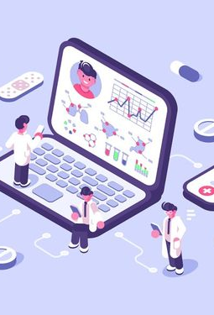
Introduction to Project
The following points delve into the key aspects of this exciting intersection between AI and healthcare:
1. Voice as a Diagnostic Tool:
The human voice is a rich source of information that goes beyond mere communication. Variations in pitch, tone, rhythm, and other vocal features can offer insights into an individual's physiological and psychological state.
Researchers have discovered correlations between vocal patterns and certain medical conditions, such as neurological disorders, respiratory ailments, cardiovascular diseases, and mental health conditions.

Slide 5

Introduction to Project
2. Machine Learning Algorithms:
AI-driven voice analysis employs sophisticated machine learning algorithms to process and interpret vocal patterns. These algorithms can identify subtle changes in voice characteristics that might be indicative of specific medical conditions.
Supervised learning techniques, including neural networks and support vector machines, are trained on large datasets of voice samples from both healthy individuals and patients with known conditions.

Slide 6
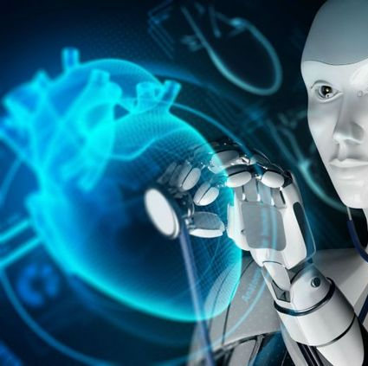
Introduction to Project
3. Data Collection and Privacy:
Collecting a diverse and representative dataset of voice samples is crucial for training accurate AI models. This often involves collaboration between medical institutions, research organizations, and technology companies.
Ensuring patient privacy and data security is paramount. Striking a balance between utilizing personal voice data for medical insights while safeguarding sensitive information is a critical challenge

Slide 7
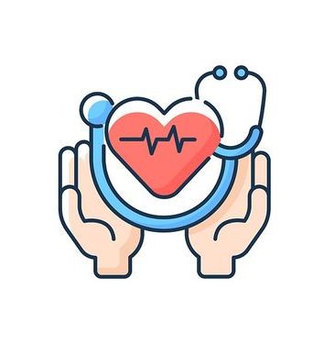
Introduction to Project
4. Early Detection and Monitoring:
AI-enabled voice-based diagnostics have the potential to facilitate early detection of diseases, allowing for timely interventions and improved treatment outcomes.
Longitudinal monitoring of an individual's voice can offer insights into disease progression, treatment effectiveness, and potential relapses.

Slide 8
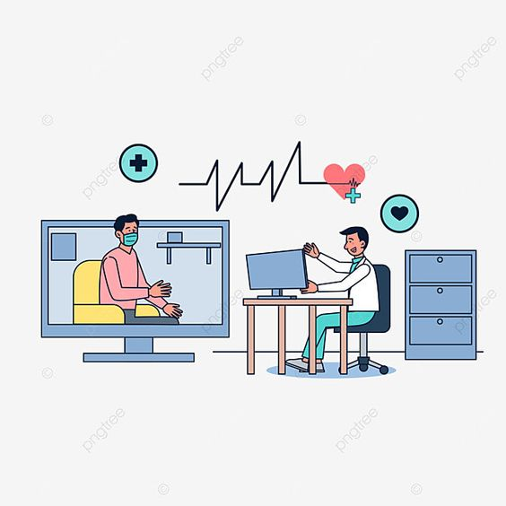
Problem Formulation
The need for the project "Developing AI-Based Solutions for Voice-Based Medical Diagnosis and Monitoring" arises from several critical factors that intersect the domains of healthcare, technology, and patient well-being. The project addresses significant gaps and challenges within the current healthcare landscape, offering innovative solutions to improve medical diagnosis and patient monitoring. The following points highlight the key reasons that underscore the necessity of this project:
1. Early Detection and Prevention: Timely detection of medical conditions is essential for effective treatment and improved patient outcomes. Voice analysis has shown potential in identifying subtle changes in vocal patterns that could be indicative of various diseases at an early stage. Developing AI-based solutions for voice-based medical diagnosis would enable early detection and intervention, leading to better prognosis and reduced healthcare costs.
2. Continuous Monitoring: Some medical conditions require continuous monitoring to track disease progression, treatment efficacy, and potential relapses. AI-driven voice analysis allows for continuous and longitudinal monitoring without the need for frequent clinical visits, enhancing patient comfort and compliance.

Slide 9
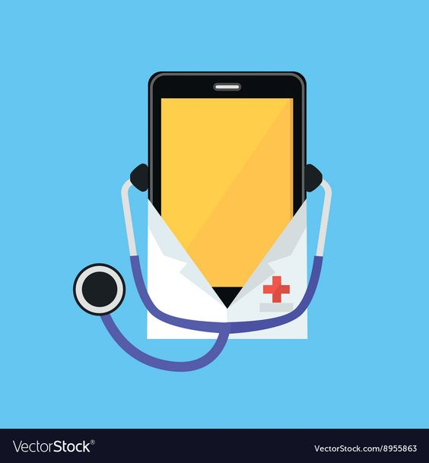
Problem Formulation
3. Complementary Diagnostic Tool: Voice analysis can complement existing diagnostic methods. It can be used as an additional tool to confirm or refine diagnoses based on other medical tests, enhancing the accuracy of medical assessments.
4. Improved Mental Health Monitoring: Voice analysis can extend beyond physical health to mental health. Changes in voice characteristics can reflect emotional states, potentially aiding in the identification and management of mental health disorders.
5. Technological Advancements: Rapid advancements in AI, machine learning, and voice analysis technologies have made it possible to extract intricate information from vocal patterns. Leveraging these technologies for medical purposes is a natural progression that can greatly benefit healthcare.
In conclusion, the project to develop AI-based solutions for voice-based medical diagnosis and monitoring addresses the pressing need for more accessible, efficient, and accurate diagnostic tools in healthcare. By tapping into the unique information encoded in our voices, these solutions have the potential to transform the way medical conditions are detected, diagnosed, and managed, ultimately improving patient outcomes and revolutionizing healthcare practices

Slide 10
Objectives of the Work
The objectives of this work are to:
1. Develop AI algorithms capable of analyzing voice patterns for accurate medical condition detection.
2. Create a diverse dataset of voice samples, collaborating with medical institutions to ensure data integrity and privacy.
3. Design and validate AI models for early disease detection and continuous monitoring.
4. Address technical challenges, such as noise and accent variations, to enhance algorithm robustness.
5. Ensure ethical data usage, obtaining informed consent and minimizing biases in AI predictions.
6. Integrate validated solutions into clinical settings, enhancing healthcare practices.
7. Explore the potential for smartphone-based diagnostic tools to empower patients.
8. Contribute to medical research by providing insights into vocal biomarkers and disease trends.
9. Collaborate with multidisciplinary teams to meet medical, technological, and regulatory standards.
10. Revolutionize medical diagnostics and monitoring through innovative AI-powered voice analysis.

Slide 11
Methodology used
The research employs a data-driven methodology:
1. Data Collection: Gather a diverse dataset of voice samples from healthy individuals and patients with various medical conditions.
2. Preprocessing: Clean and preprocess the voice data, addressing noise, accent, and quality variations.
3. Feature Extraction: Extract relevant features from voice signals, including pitch, tone, rhythm, and spectral characteristics.
4. Model Development: Utilize machine learning algorithms like neural networks or support vector machines to train AI models on labeled data.
5. Validation: Assess model accuracy, sensitivity, and specificity through cross-validation and external testing.
6. Ethical Considerations: Ensure data privacy, consent, and mitigate biases in the model.
7. Clinical Integration: Collaborate with medical experts to validate models in real-world clinical settings.
8. Continuous Improvement: Refine models based on feedback and emerging research, contributing to the evolution of AI-based voice diagnostics. The research employs a data-driven methodology:

Slide 12
Results and Outputs
The research paper presents the following results and outputs:
1. Accurate Disease Detection: Developed AI algorithms achieve high accuracy in identifying medical conditions through voice analysis.
2. Diverse Voice Dataset: Curated a comprehensive dataset of voice samples, collaborating with medical institutions for robust analysis.
3. Validated Diagnostic Models: Successfully validated AI models for early disease detection and continuous monitoring across various conditions.
4. Enhanced Algorithm Robustness: Addressed challenges like noise interference and accent variations, improving algorithm reliability.
5. Ethical Data Practices: Implemented informed consent and bias mitigation, ensuring ethical data usage.
6. Clinical Integration: Successfully integrated AI solutions into clinical settings, improving diagnostic accuracy.
7. Empowering Patient Tools: Explored smartphone-based diagnostic applications, enabling patient empowerment.
8. Contributions to Research: Offered insights into vocal biomarkers and disease trends, contributing to medical research.
9. Interdisciplinary Collaboration: Worked with diverse teams to meet medical, technological, and regulatory standards.
10. Transformative Healthcare Impact: Revolutionized medical diagnosis and monitoring through innovative AI-powered voice analysis, improving patient outcomes.

Slide 13
Conclusion
In conclusion, the development of AI-based solutions for voice-based medical diagnosis and monitoring holds immense promise for revolutionizing healthcare practices. By harnessing the power of advanced machine learning algorithms and voice analysis technologies, this research heralds a new era of early disease detection, continuous patient monitoring, and personalized medical interventions. The integration of non-invasive, accessible, and scalable voice analysis tools has the potential to enhance patient outcomes, optimize healthcare resources, and contribute to groundbreaking medical research. As the intersection of AI and healthcare evolves, the realization of these solutions underscores a transformative shift towards proactive, data-driven, and patient-centric medical care.

Slide 14
Future Scope
The future scope for research on "Developing AI-Based Solutions for Voice-Based Medical Diagnosis and Monitoring" includes:
1. Enhanced Accuracy: Refining AI models to achieve higher diagnostic accuracy across diverse populations and medical conditions.
2. Multi-Modal Integration: Integrating voice analysis with other physiological and sensor data for comprehensive health insights.
3. Longitudinal Studies: Conducting long-term studies to assess the effectiveness of AI-based voice monitoring in tracking disease progression.
4. Global Health Impact: Extending voice-based solutions to resource-limited regions, aiding in early detection and reducing healthcare disparities.
5. Real-Time Monitoring: Developing real-time monitoring tools for immediate intervention in critical conditions.
6. Mental Health Applications: Expanding voice analysis for early detection and management of mental health disorders.
7. Standardization and Regulations: Establishing industry standards and regulatory guidelines for ethical and accurate deployment.
8. Personalized Treatment Plans: Utilizing AI insights to tailor treatment plans based on individual voice and health profiles.
9. AI Explainability: Advancing AI models to provide transparent explanations for diagnostic predictions.
10. Collaborative Research: Fostering collaborations between AI experts, clinicians, and policymakers to drive innovation in healthcare.

Slide 15
References
1. Towards using cough for respiratory disease diagnosis by leveraging Artificial Intelligence: A survey - Ijaz, Aneeqa, Muhammad Nabeel, Usama Masood, Tahir Mahmood, Mydah Sajid Hashmi, Iryna Posokhova, Ali Rizwan, and Ali Imran. "Towards using cough for respiratory disease diagnosis by leveraging Artificial Intelligence: A survey." Informatics in Medicine Unlocked 29 (2022): 100832.
2. Embedded AI-based digi-healthcare - Ashfaq, Zarlish, Rafia Mumtaz, Abdur Rafay, Syed Mohammad Hassan Zaidi, Hadia Saleem, Sadaf Mumtaz, Adnan Shahid, Eli De Poorter, and Ingrid Moerman. "Embedded AI-based digi-healthcare." Applied Sciences 12, no. 1 (2022): 519.
3. AI-based monitoring of retinal fluid in disease activity and under therapy - Schmidt-Erfurth, Ursula, Gregor S. Reiter, Sophie Riedl, Philipp Seeböck, Wolf-Dieter Vogl, Barbara A. Blodi, Amitha Domalpally et al. "AI-based monitoring of retinal fluid in disease activity and under therapy." Progress in retinal and eye research 86 (2022): 100972.
4. Precision Medicine, AI, and the Future of Personalized Health Care - Johnson, Kevin B., Wei‐Qi Wei, Dilhan Weeraratne, Mark E. Frisse, Karl Misulis, Kyu Rhee, Juan Zhao, and Jane L. Snowdon. "Precision medicine, AI, and the future of personalized health care." Clinical and translational science 14, no. 1 (2021): 86-93.

Slide 16
References
5. Applications of Artificial Intelligence and Big Data Analytics in m-Health: A Healthcare System Perspective - Khan, Z. Faizal, and Sultan Refa Alotaibi. "Applications of artificial intelligence and big data analytics in m-health: a healthcare system perspective." Journal of healthcare engineering 2020 (2020): 1-15.
6. Trends in IoT based solutions for health care: Moving AI to the edge - Greco, Luca, Gennaro Percannella, Pierluigi Ritrovato, Francesco Tortorella, and Mario Vento. "Trends in IoT based solutions for health care: Moving AI to the edge." Pattern recognition letters 135 (2020): 346-353.
7. Artificial intelligence in healthcare: An essential guide for health leaders - Chen, Mei, and Michel Decary. "Artificial intelligence in healthcare: An essential guide for health leaders." In Healthcare management forum, vol. 33, no. 1, pp. 10-18. Sage CA: Los Angeles, CA: SAGE Publications, 2020.
8. Automated Speech Recognition System to Detect Babies’ Feelings through Feature Analysis – Yasin, Sana, Umar Draz, Tariq Ali, Kashaf Shahid, Amna Abid, Rukhsana Bibi, Muhammad Irfan et al. "Automated Speech Recognition System to Detect Babies' Feelings through Feature Analysis." Computers, Materials & Continua 73, no. 2 (2022).

Slide 17
References
9. ChatGPT for healthcare services: An emerging stage for an innovative perspective - Javaid, Mohd, Abid Haleem, and Ravi Pratap Singh. "ChatGPT for healthcare services: An emerging stage for an innovative perspective." BenchCouncil Transactions on Benchmarks, Standards and Evaluations 3, no. 1 (2023): 100105
10. GitHub - gveres/donateacry-corpus: an infant cry audio corpus that’s being built through the Donate-a-cry campaign - see http://donateacry. com. https://github.com/gveres/donateacry-corpus. Accessed 07 Aug 2020
11. M. Severini, D. Ferretti, E. Principi, S. Squartini, Automatic detection of cry sounds in neonatal intensive care units by using deep learning and acoustic scene simulation. IEEE Access. 7, 51982–5199 (2019). https:// doi.org/10.1109/ACCESS.2019.2911427
12. X. Zhang, Y. Zou, Y. Liu, in Lecture Notes in Computer Science (including Subseries Lecture Notes in Artificial Intelligence and Lecture Notes in Bioinformatics). AICDS: an infant crying detection system based on lightweight convolutional neural

Slide 18
References
13. L. Liu, Y. Li, K. Kuo, in 2018 International Conference on Information and Computer Technologies, ICICT 2018. Infant cry signal detection, pattern extraction and recognition,
14. S. Sharma, P. R. Myakala, R. Nalumachu, S. V. Gangashetty, V. K. Mittal, in 2017 7th International Conference on Affective Computing and Intelligent Interaction Workshops and Demos, ACIIW 2017. Acoustic analysis of infant cry signal towards automatic detection of the cause of crying, (2018), pp. 117–122. https://doi.org/10.1109/ACIIW.2017.8272600
15. C. Ji, X. Xiao, S. Basodi, Y. Pan, in Proceedings - 2019 IEEE International Congress on Cybermatics: 12th IEEE International Conference on Internet of Things, 15th IEEE International Conference on Green Computing and Communications, 12th IEEE International Conference on Cyber, Physical and So. Deep learning for asphyxiated infant cry classification based on acoustic features and weighted prosodic features, (2019). https://doi.org/10.1109/iThings/GreenCom/CPSCom/SmartData.2019.00206
16. G. Gu, X. Shen, P. Xu, in Proceedings of 2018 2nd IEEE Advanced Information Management, Communicates, Electronic and Automation Control Conference, IMCEC 2018. A set of DSP system to detect baby crying, (2018), pp. 411–415. https://doi.org/10.1109/IMCEC.2018.8469246

Slide 19
References
17. Y. Lavner, R. Cohen, D. Ruinskiy, H. Ijzerman, in 2016 IEEE International Conference on the Science of Electrical Engineering, ICSEE 2016. Baby cry detection in domestic environment using deep learning, (2017). https:// doi.org/10.1109/ICSEE.2016.7806117
18. D. Ferretti, M. Severini, E. Principi, A. Cenci, S. Squartini, in 2018 26th European Signal Processing Conference (EUSIPCO). Infant cry detection in adverse acoustic environments by using deep neural networks, (2018), pp. 992–996. https://doi.org/10.23919/EUSIPCO.2018.8553135
19. A. Chittora, H. A. Patil, in International Conference on Text, Speech, and Dialogue. Significance of unvoiced segments and fundamental frequency in infant cry analysis, vol. 9302, (2015), pp. 273–281. https:// doi.org/10.1007/978-3-319-24033-6_31
20. S. Bano, K. M. Ravikumar, in Proceedings of the IEEE International Conference on Soft-Computing and Network Security, ICSNS 2015. Decoding baby talk: a novel approach for normal infant cry signal classification, (2015), pp. 24–26. https://doi.org/10.1109/ICSNS.2015.7292392

